Slide 1
1 hop
N1
2 hop
Ns
N2
Nd
・・・
Nn

Slide 2










Cancel rebroadcast
$$N_{2}$$
$$N_{2}$$
×
priority2
relay time:0.04s
$$N_{s}$$
priority1
$$N_{1}$$
$$N_{d}$$
$$N_{s}$$
$$N_{1}$$
$$N_{d}$$
relay time:0s
priority3
・・・
$$N_{n}$$
×
$$N_{n}$$
×
relay time:0.12s
Cancel rebroadcast

Slide 3

$$N_{2}$$
再ブロードキャストキャンセル
中継タイマー: 0.04s
$$N_{2}$$
×
$$N_{s}$$
$$N_{1}$$
$$N_{d}$$
中継タイマー: 0s
・・・
$$N_{s}$$
$$N_{1}$$
$$N_{d}$$
$$N_{n}$$
中継タイマー: 0.12s
×
$$N_{n}$$
×
再ブロードキャストキャンセル

Slide 4


$$N_{2}$$
再ブロードキャストキャンセル
$$N_{2}$$
×
中継タイマー: 0.04s
$$N_{s}$$
$$N_{1}$$
$$N_{d}$$
$$N_{s}$$
$$N_{1}$$
$$N_{d}$$
中継タイマー: 0s
・・・
$$N_{n}$$
中継タイマー: 0.12s
×
$$N_{n}$$
×
再ブロードキャストキャンセル

Slide 5


RCS1
$$N_{s}$$
$$N_{d}$$
RCS4
RCS3
RCS2

Slide 6







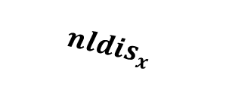





RCS候補
$$z$$
$$P$$
$$cldis$$
$$S$$
$$y$$
$$mndis_{x}$$
$$nldis_{x}$$
$$x$$
$$w$$
$$S$$
: 送信ノード
$$P$$
: 1ホップ前のノード
$$x, y, z$$
: RCSの条件を満たすノード
$$w$$
: RCSの条件を満たさないノード

Slide 7




$$N_{s}$$
$$N_{d}$$
Gegraphic Route
Opportunistic Route
Opportunistic Relay
Wireless Link
$$N_{s}$$
Source Node
$$N_{d}$$
Destination Node

Slide 8
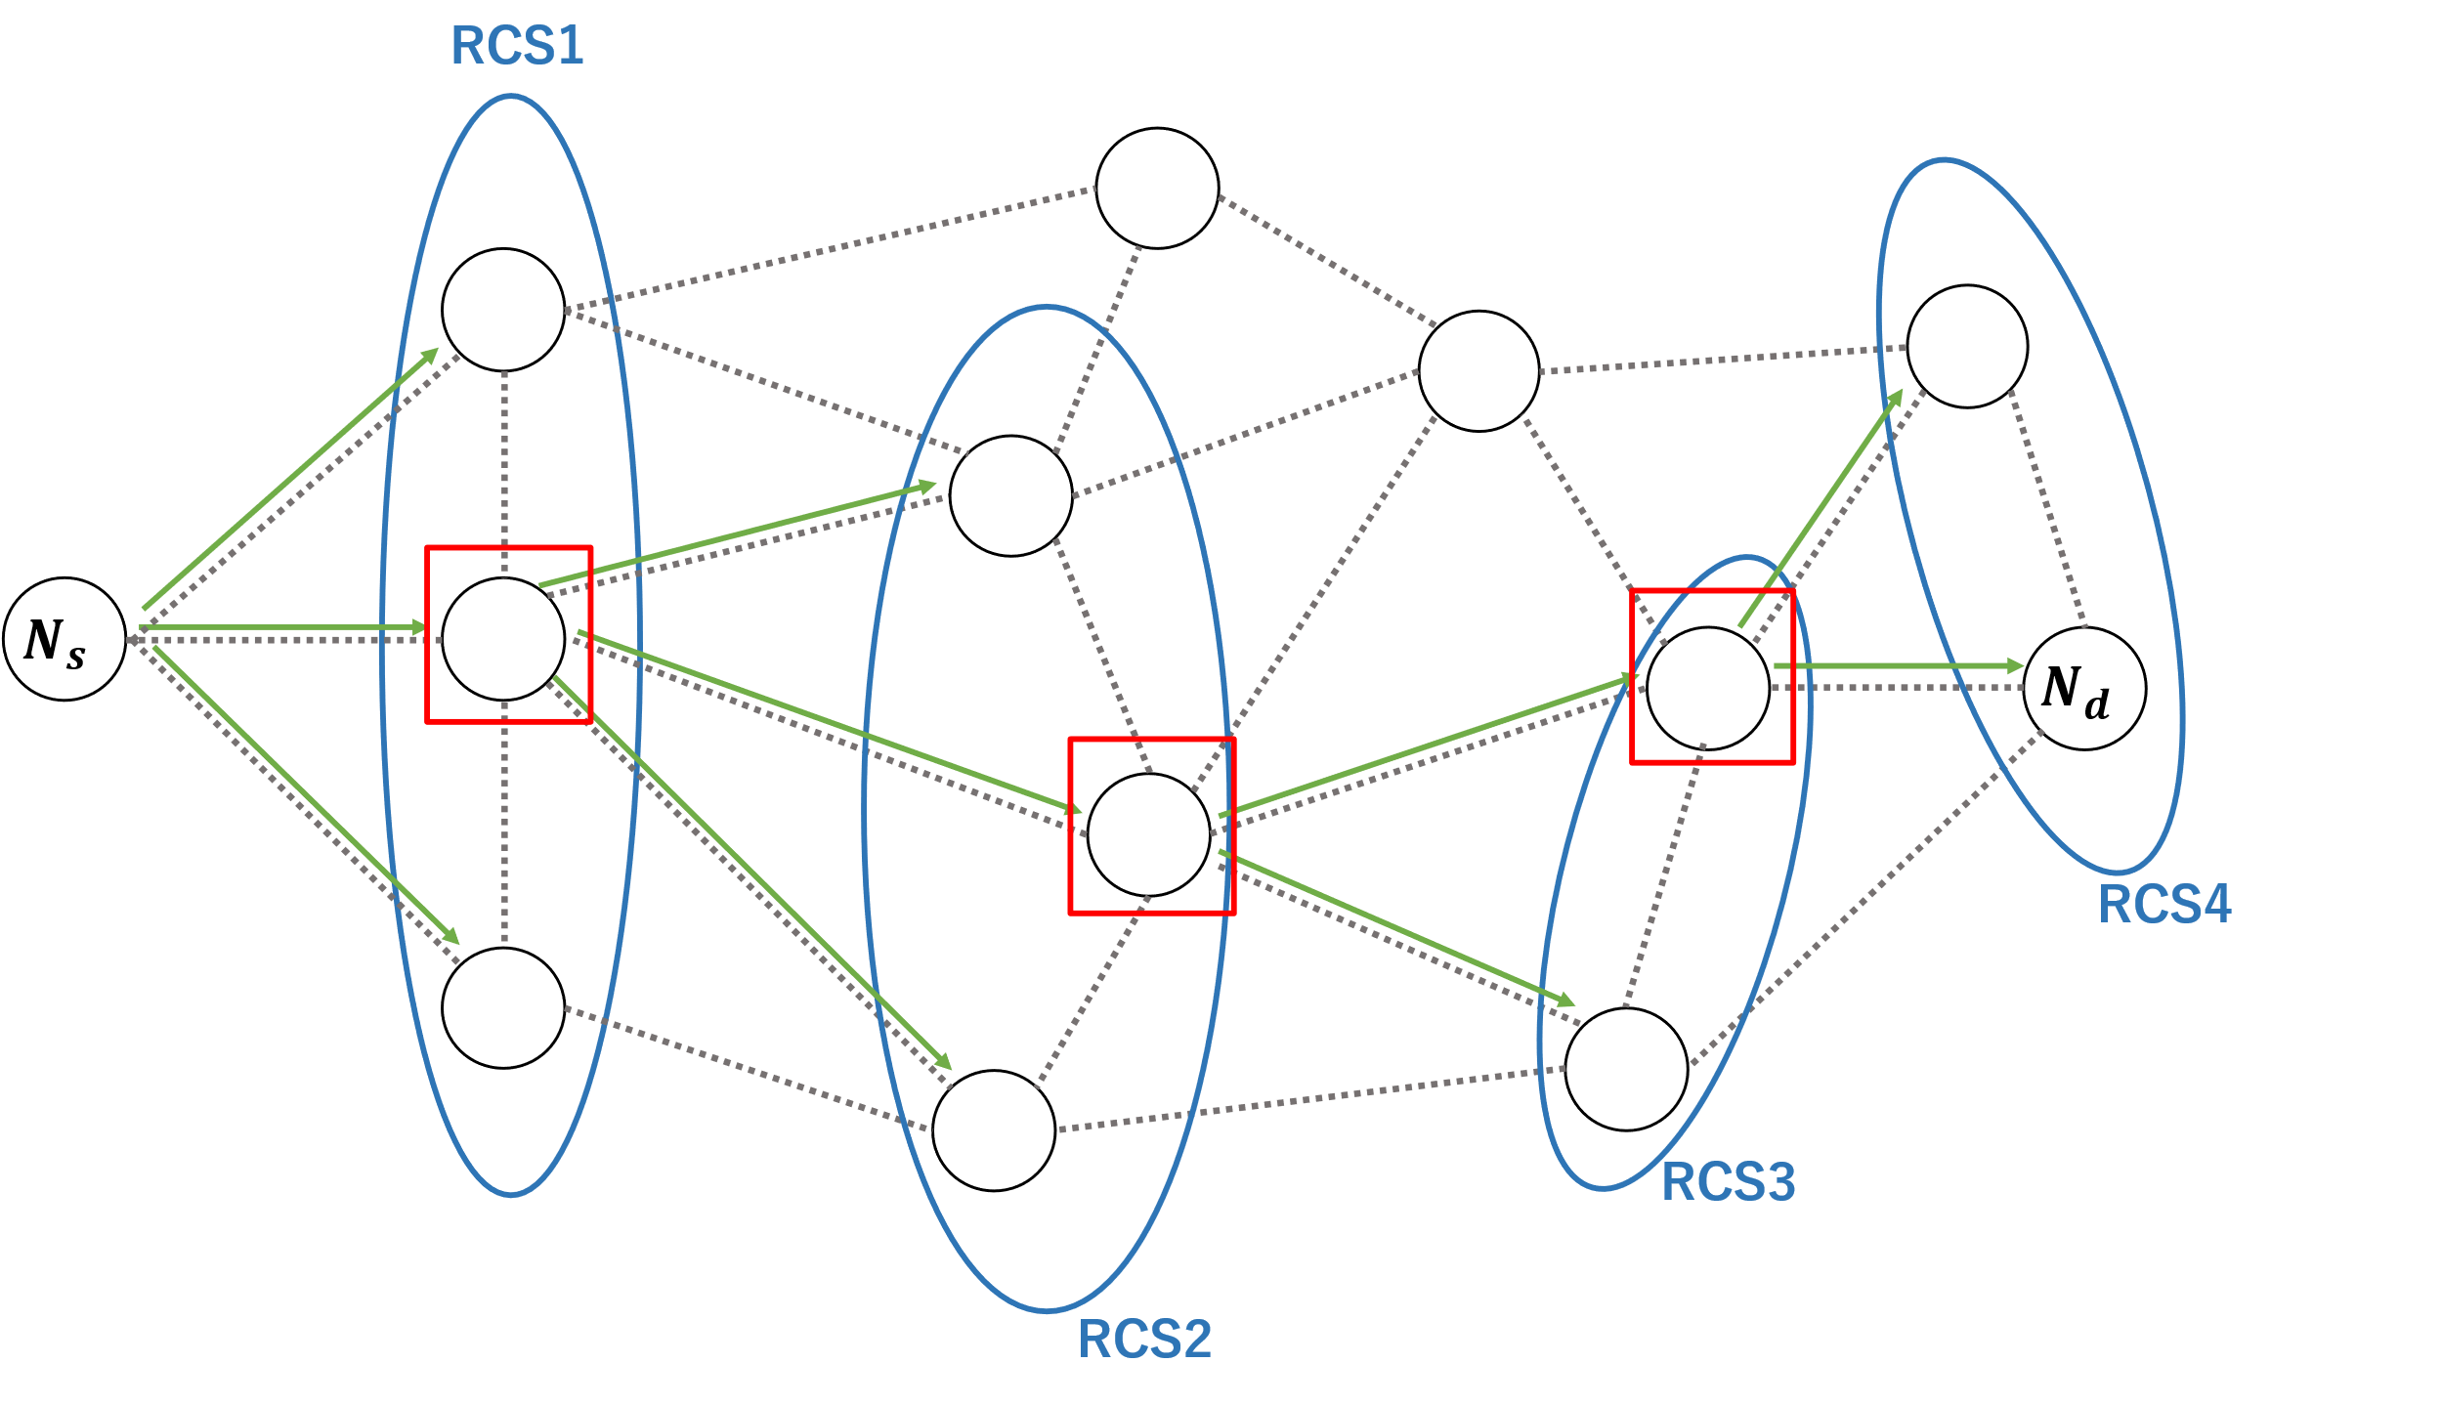
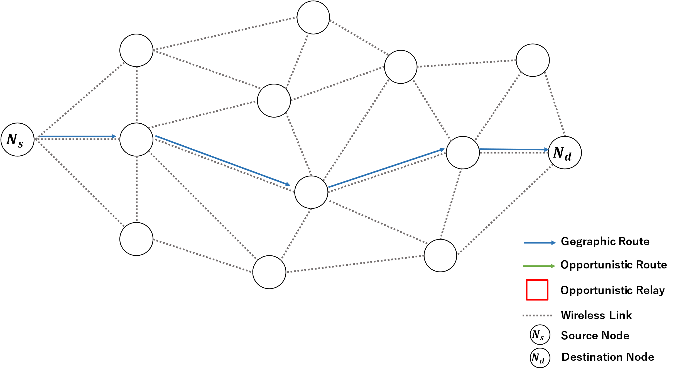

Slide 9
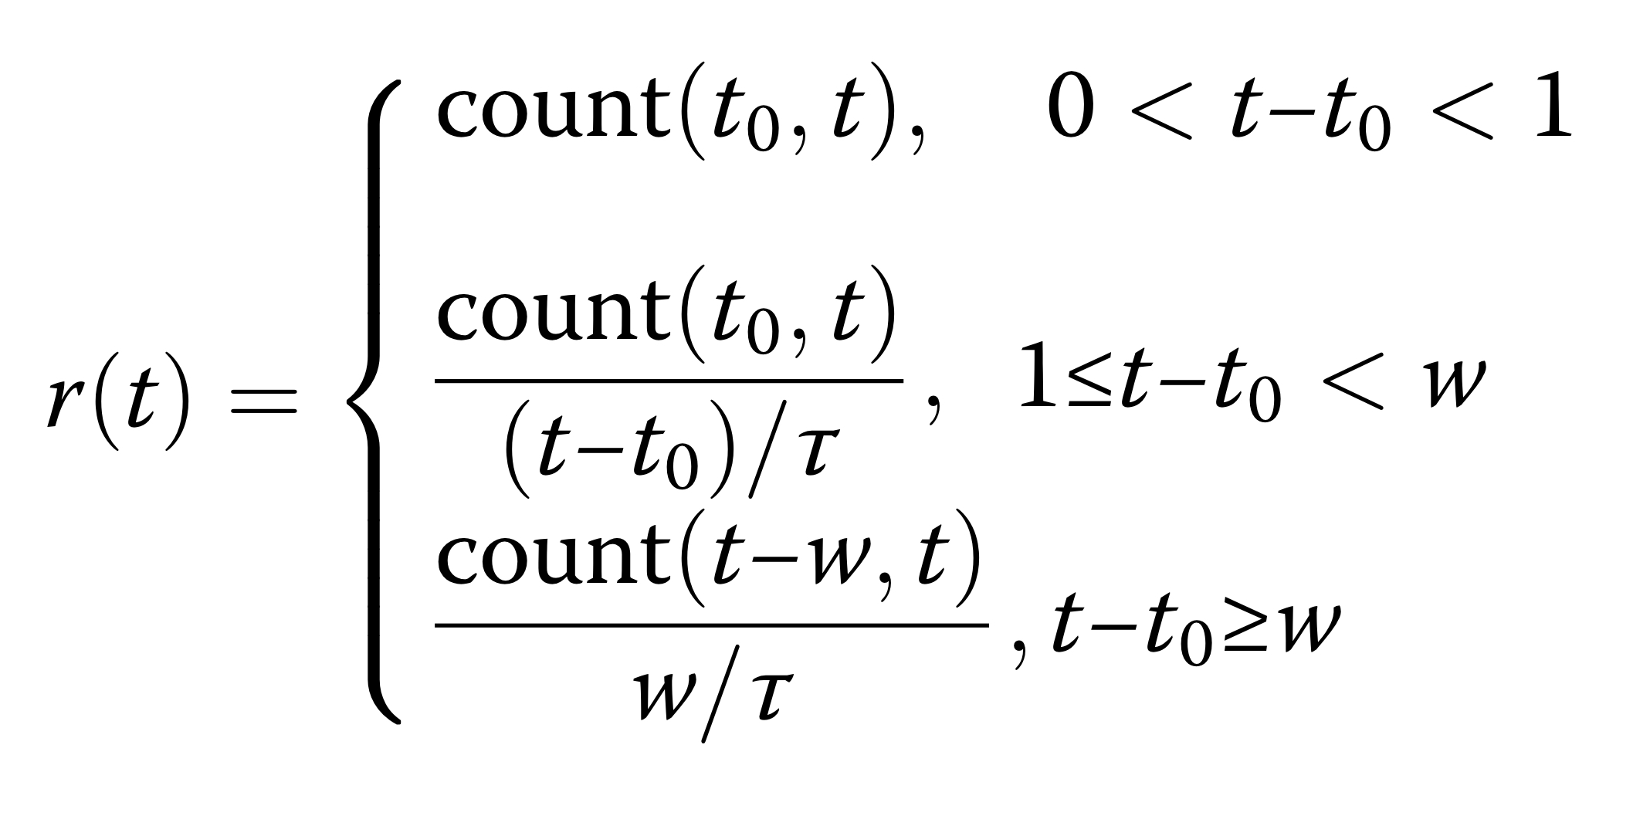

Slide 10
N1
D1d
Dsd
Ns
Nd
D2d
N2
・・・
Nn

Slide 11
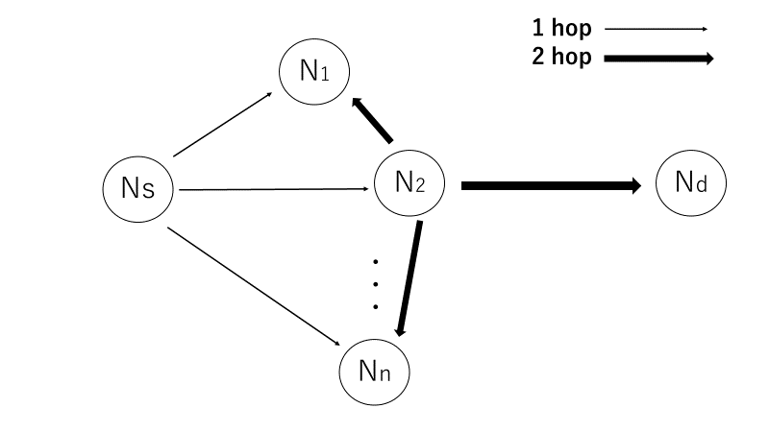
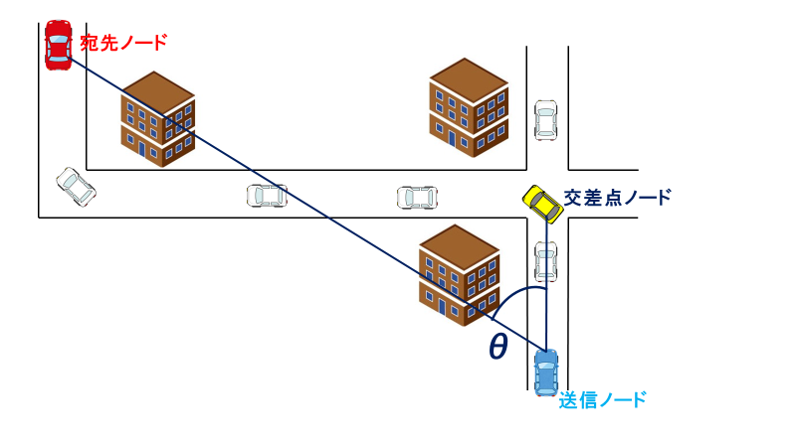

Slide 12


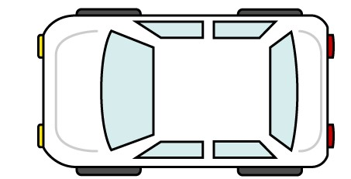


宛先ノード
交差点ノード
θ
送信ノード

Slide 13
Building
4
目的地方向
3
2
交差点ノード
1

Slide 14
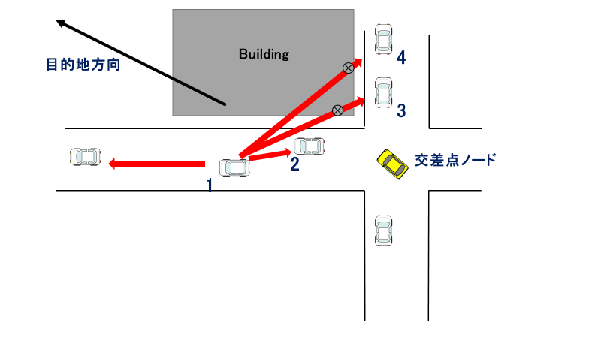

Slide 15
D
３
S
２
１
S

Slide 16
D
３
S
２
１
S

Slide 23

Building Area
Two-way street
300 m
300 m

Slide 24
Building Area
Two-way street
300 m
300 m

Slide 25
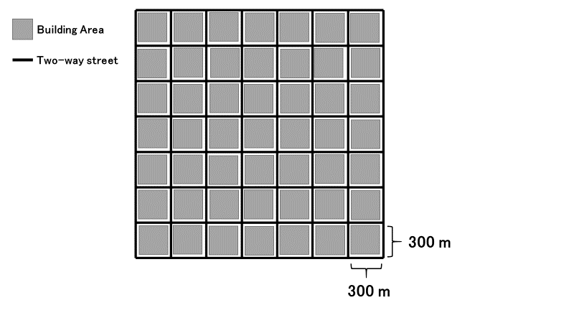
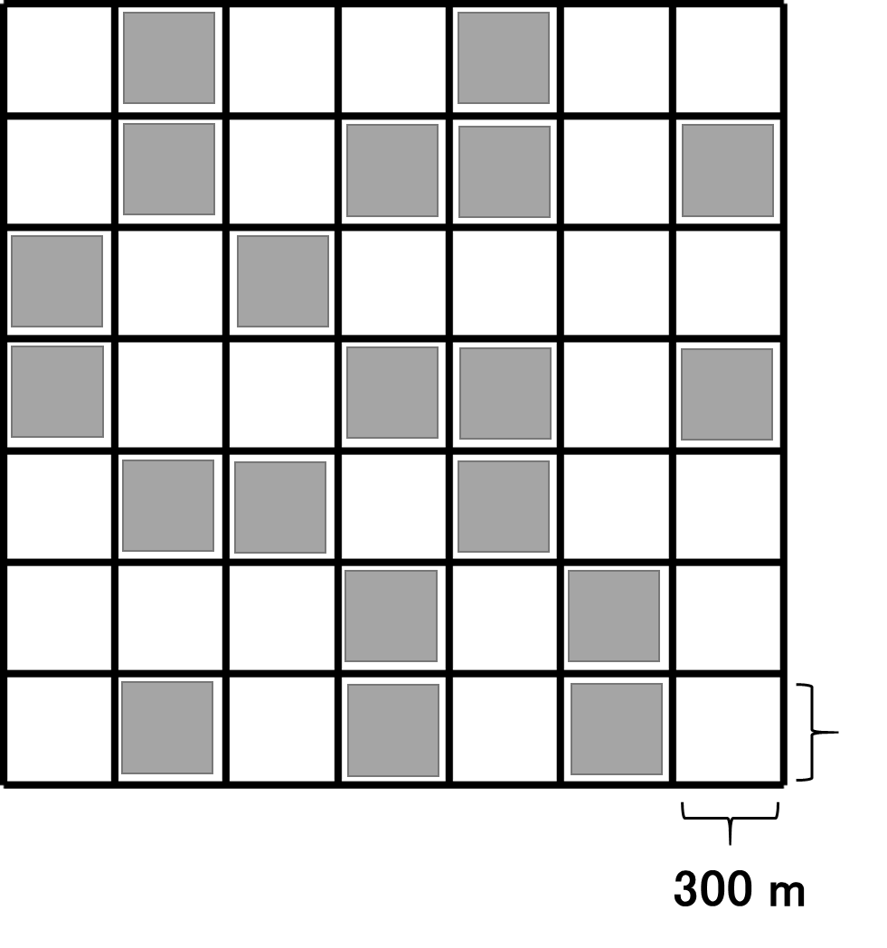

Slide 26
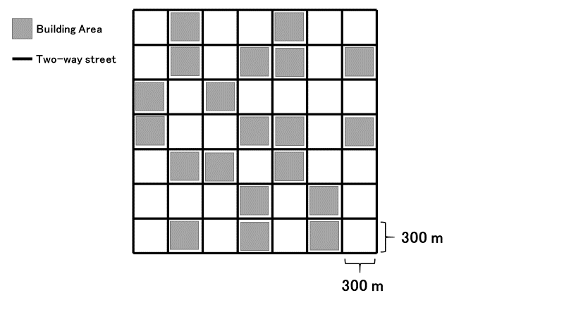

Slide 27
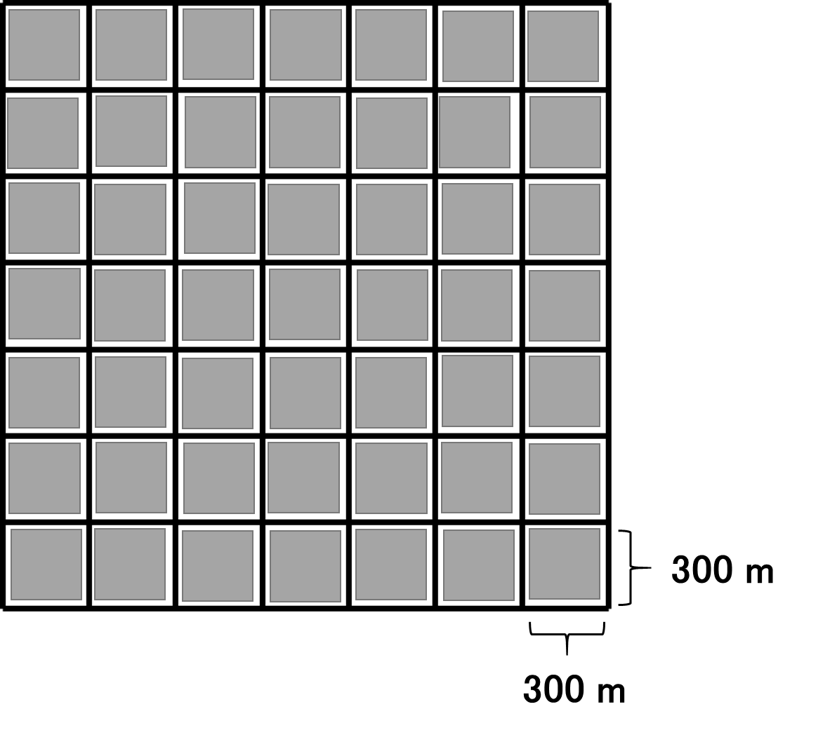
Building Area
Two-way street

Slide 28
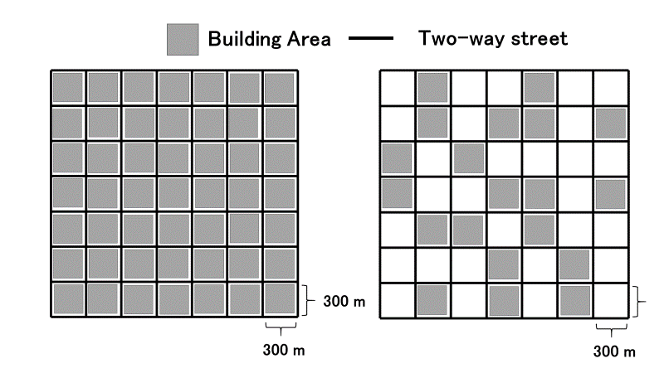

Slide 29
Building
Gray-Zone

Slide 30
宛先ノード
道路の中心座標
θ
交差点車両
Building
送信車両

Slide 31

$$SourceId$$ | $$DstId$$ | $$DstXpos$$ | $$DstYpos$$ | $$ID_{1}$$ | $$ID_{2}$$ | $$ID_{i}$$ | ... | $$ID_{N}$$ | $$Data$$
header
Data packet format
$$ID$$ | $$X$$ | $$Y$$ | $$v$$ | $$a$$ | $$θ$$
Hello packet format

Slide 32


Destination Node
Building
Building
Closest road segment
$$r_{1}\left(t\right)$$
$$r_{2}\left(t\right)$$
Intersection area
Transmitting Node
Road center coordinates

Slide 33
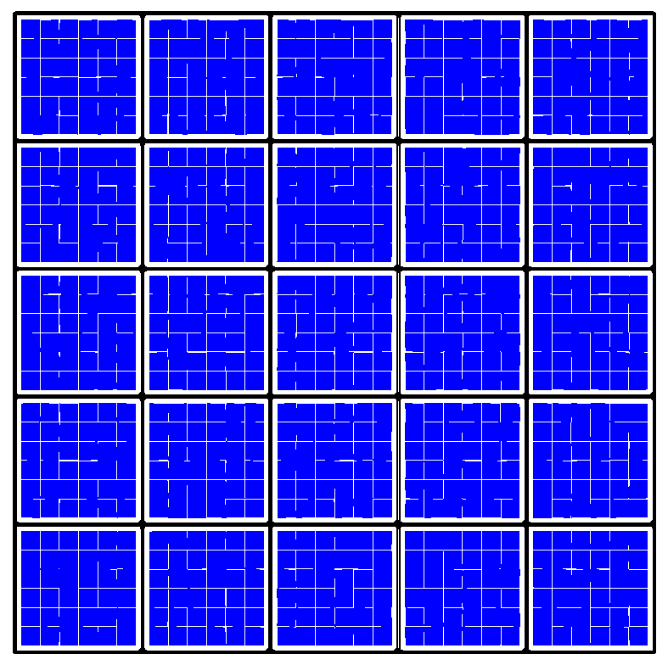
Destination area
Source area

Slide 34

Destination Node
Building
Building
$$θ_{I}$$
Intersection node
Transmitting Node

Slide 35


Slide 36
Inefficient route
no shadowing
shadowing
efficient route
Destination Node
Building
Building
Building
③
③
①
②
Send Node
Building

Slide 37
Destination Node
Destination Node
Building
Building
C
×
×
D
A
A
Building
Building
B
B
(a) unreachable case in LSGO
(b) reachable case

Slide 38
Intersection-based routing
Other routing schemes
Building
Building
Destination Node
Building

Slide 45
Destination direction
Building
Building
1
2
3
Intersection node
4

Slide 46
(a) simulation scenario
(b) packet delivery ratio
(c) overhead

Slide 47


Destination Node
Building
Building
Closest road segment
$$r_{1}\left(t\right)$$
$$r_{2}\left(t\right)$$
送信ノード
Intersection area
中心座標

Slide 48



D
D
minanle2
sdangle
R2
$$r_{1}\left(t\right)$$
minanle1
snangle2
R1
$$r_{2}\left(t\right)$$
$$θ_{I}$$
snangle1
S
Transmitting node
Destination
LSN
Destination
Intersection node
Road center coordinates
PLSN
Relay candidate node
Closest road segment
Road segment
Transmitting node
(a)The closest road segment
(b)Minimum angle method

Slide 49

D
D
minanle2
sdangle
R2
$$r_{1}\left(t\right)$$
minanle1
snangle2
R1
$$r_{2}\left(t\right)$$
$$θ_{i}$$
snangle1
Transmitting node
Destination
LSN
Destination
Intersection node
Road center coordinates
PLSN
Relay candidate node
Closest road segment
Road segment
Transmitting node
(a)The closest road segment
(b)Minimum angle method

Slide 50



D
D
minanle2
sdangle
R2
$$r_{1}\left(t\right)$$
minanle1
snangle2
R1
$$r_{2}\left(t\right)$$
$$θ_{i}$$
snangle1
Transmitting node
Destination
LSN
Destination
Intersection node
Road center coordinates
PLSN
Relay candidate node
Closest road segment
Road segment
Transmitting node
(a)The closest road segment
(b)Minimum angle method

Slide 51


D
$$r_{1}\left(t\right)$$
$$r_{2}\left(t\right)$$
送信ノード
宛先ノード
交差点ノード
Road segmentの中心座標
Closest road segment
Road segment

Slide 52

D
$$θ_{i}$$
送信ノード
宛先ノード
交差点ノード
Intersection area

Slide 53




D
1
2
$$θ_{i}$$
3
$$X$$
$$Y$$
$$Z$$
送信ノード
宛先ノード
交差点ノード
Intersection area

Slide 54
D
minanle2
sdangle
R2
minanle1
snangle2
R1
snangle1
LSN
Destination
PLSN
送信ノード
RCSの条件を満たすノード

Slide 55
D
S
Local optimum
problem 発生

Slide 56
D
1
×
×
3
S
2

Slide 57



Recovery 成功
$N_{1}$より宛先に近い
$$N_{2}$$
D
S
$$N_{1}$$
Local optimum
problem 発生
Greedy Route
Recovery Route

Slide 58
z
u
D
y
D
w
x
x
S
Transmission range
Perimeter forwarding
Right-hand rule

Slide 59




D
宛先の方向にノードがいない
$$y$$
$$x$$
$$C_{1}$$
S
Local optimum
problem 発生
最小角度法により$xを$選択する
Greedy Route
Recovery Route

Slide 60














$$Z$$
$$Z$$
$$D$$
$$D$$
$$Y$$
×
×
$$X$$
$$Y$$
$$X$$
$$S$$
$$V$$
$$W$$
$$S$$
$$V$$
$$W$$
Local optimum problem
(a)
(b)
SIGO Route
LSGO Route

Slide 61











$$A$$
$$O$$
$$B$$
Geocast Region
$$P$$
$$Q$$
×
$$X$$
$$Z$$
$$W$$
$$Y$$
Forwarding Region
$$S$$
$$C$$
Network Space

Slide 62






Geocast Region
Center Coordinates
$$Dist_{w}$$
$$Dist_{x}$$
$$Dist_{y}$$
$$W$$
$$Dist_{s}$$
$$X$$
×
$$S$$
$$Y$$
Network Space

Slide 63
Geocast Region
Center Coordinates
$$S$$
Network Space
SIGO forwarding
Flooding
RCS

Slide 64

D
minanleB
B
A
minanleA
S
$$C_{1}$$
最小角度法を用いて中継ノードを決定
同一の道路内ではGreedy fowarding
交差点ノードが存在する場合のルート
交差点ノードが存在しない場合のルート

Slide 65
D
minangleB
B
A
minangleA
S
$$C_{1}$$
Local optimum problem
交差点ノードが存在する場合のルート
交差点ノードが存在しない場合のルート

Slide 66





D
minanleB
B
A
minanleA
$${mndis}_{3}$$
$$N_{4}$$
$$N_{1}$$
LSN
$$N_{3}$$
$$N_{2}$$
式4.7 が適応される範囲

Slide 67
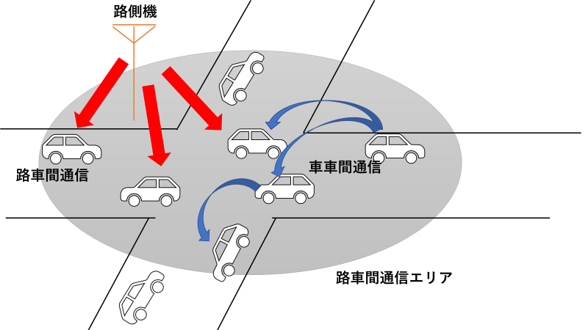

Slide 68
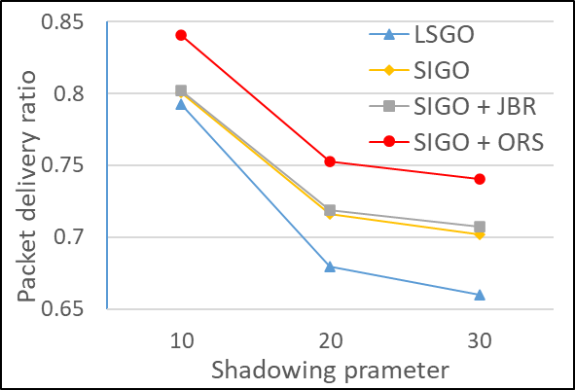
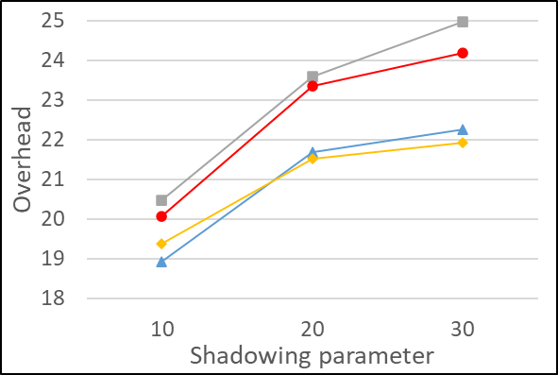
(a) simulation scenario
(b) packet delivery ratio
(c) overhead

Slide 69
(a) simulation scenario
(b) packet delivery ratio
(c) overhead

Slide 70
D
minanle2
sdangle
R2
minanle1
snangle2
R1
snangle1
S
Local source node
Destination
Previous local source node
Relay candidate node
(b)Minimum angle method

Slide 71
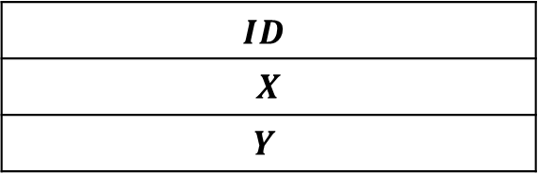
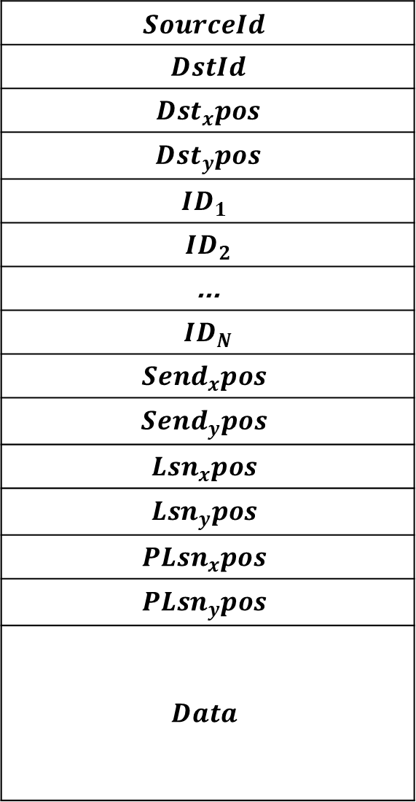
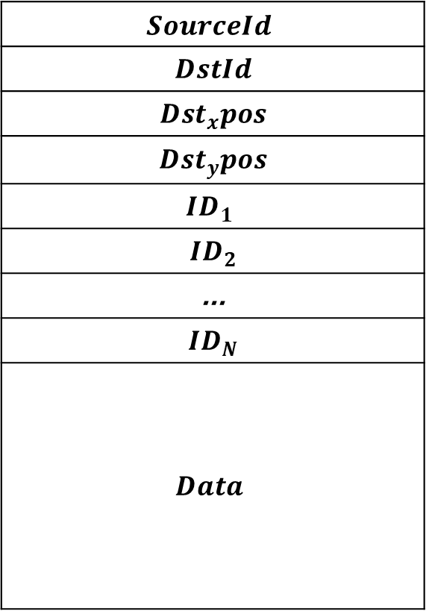
$$SourceId$$
$$DstId$$
$$Dst_{x}pos$$
$$Dst_{y}pos$$
$$ID_{1}$$
$$ID_{2}$$
$$\text{...}$$
$$ID_{N}$$
$$Data$$
$$SourceId$$
$$DstId$$
$$Dst_{x}pos$$
$$Dst_{y}pos$$
$$ID_{1}$$
$$ID_{2}$$
$$\text{...}$$
$$ID_{N}$$
$${Send}_{x}pos$$
$${Send}_{y}pos$$
$$Lsn_{x}pos$$
$$Lsn_{y}pos$$
$$PLsn_{x}pos$$
$$PLsn_{y}pos$$
$$Data$$
$$ID$$
$$X$$
$$Y$$

